Slide 1



HR DAshboard
View in Power BI
Last data refresh:
23/07/2023 17:27:18 UTC
Downloaded at:
23/07/2023 17:54:36 UTC

Slide 2
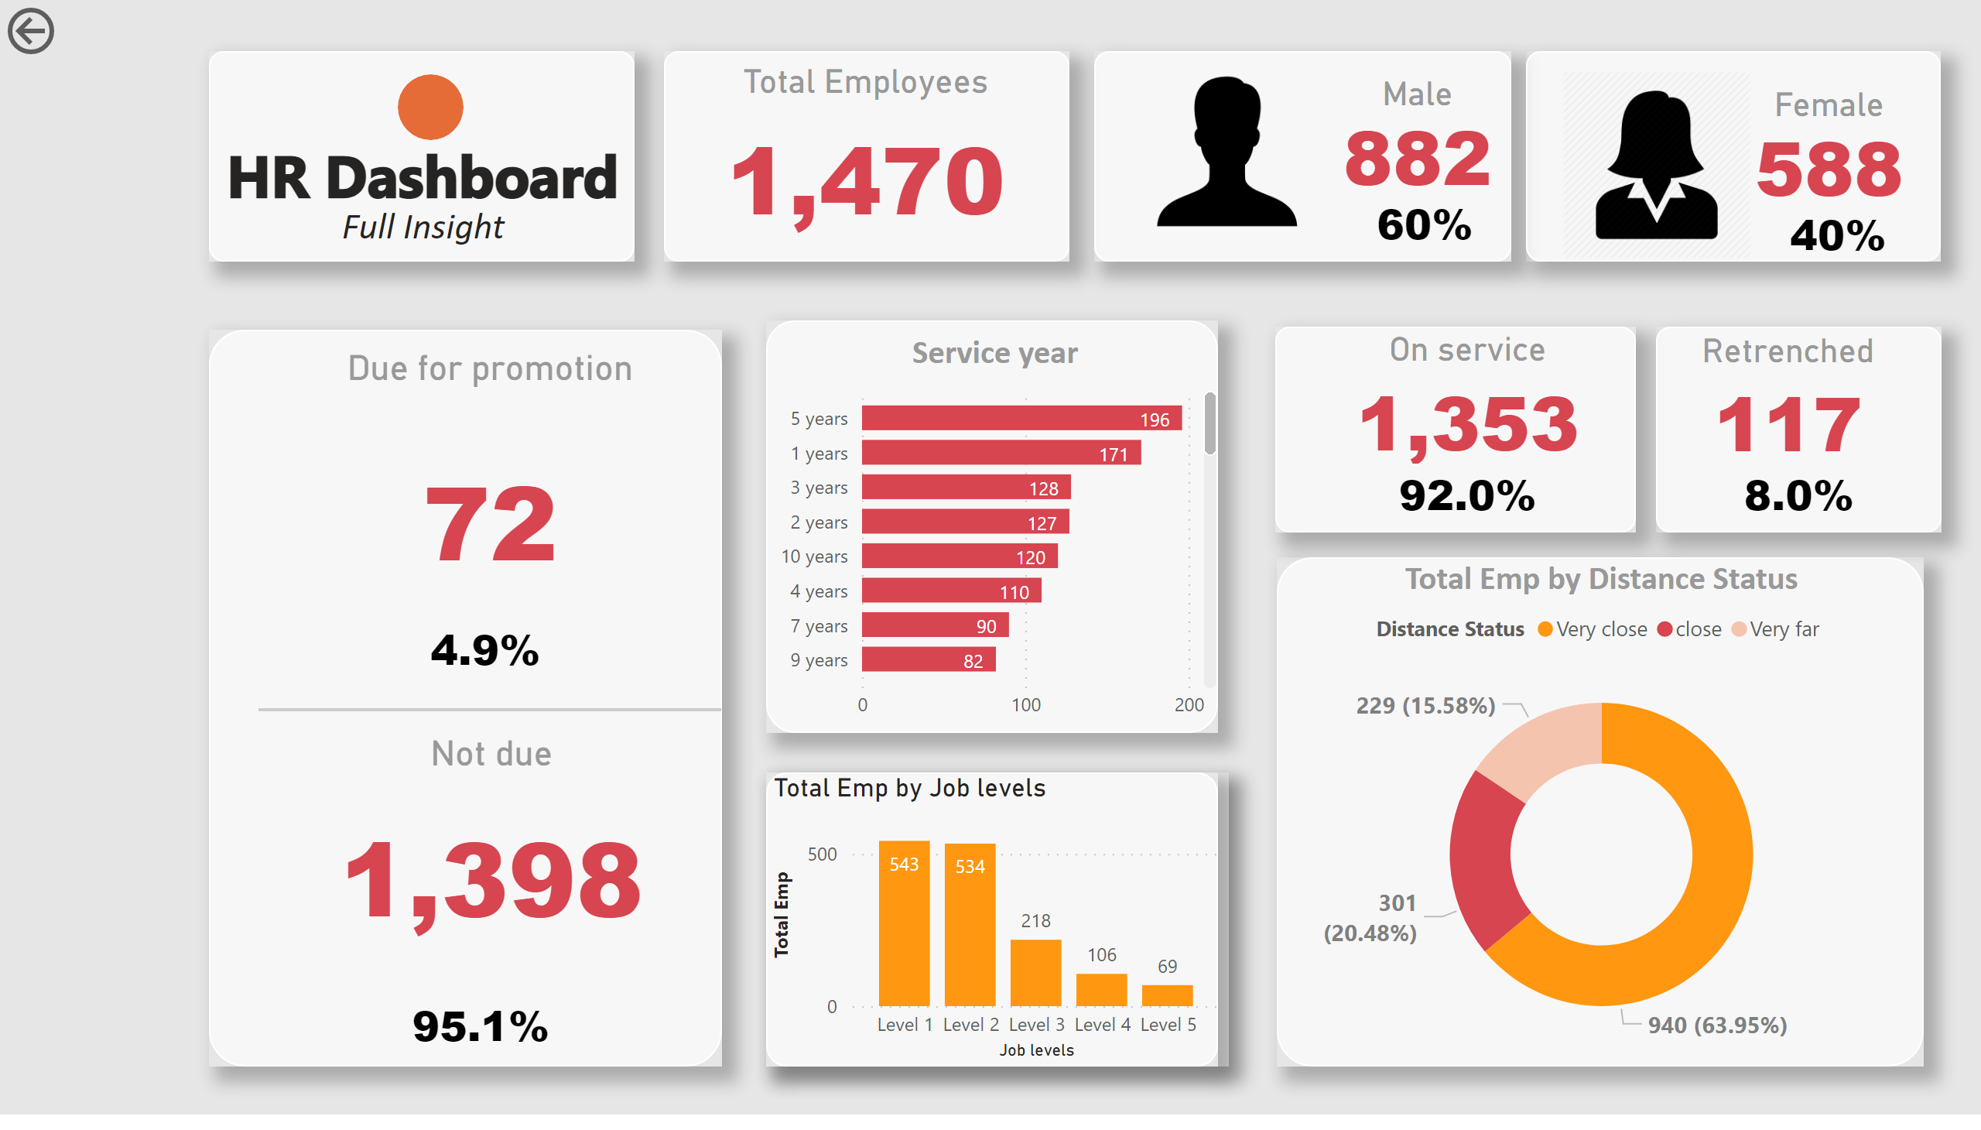
Home
Notes:
shape
No alt text provided
shape
No alt text provided
shape
No alt text provided
shape
No alt text provided
shape
No alt text provided
shape
No alt text provided
shape
No alt text provided
shape
No alt text provided
shape
No alt text provided
shape
No alt text provided
textbox
No alt text provided
textbox
No alt text provided
shape
No alt text provided
Total Employees
No alt text provided
Male
No alt text provided
Male
No alt text provided
Male
No alt text provided
Female
No alt text provided
image
No alt text provided
image
No alt text provided
Due for promotion
No alt text provided
Male
No alt text provided
Not due
No alt text provided
Male
No alt text provided
shape
No alt text provided
Service year
No alt text provided
columnChart
No alt text provided
actionButton
No alt text provided
On service
No alt text provided
Male
No alt text provided
Retrenched
No alt text provided
Male
No alt text provided
donutChart
No alt text provided

Slide 3
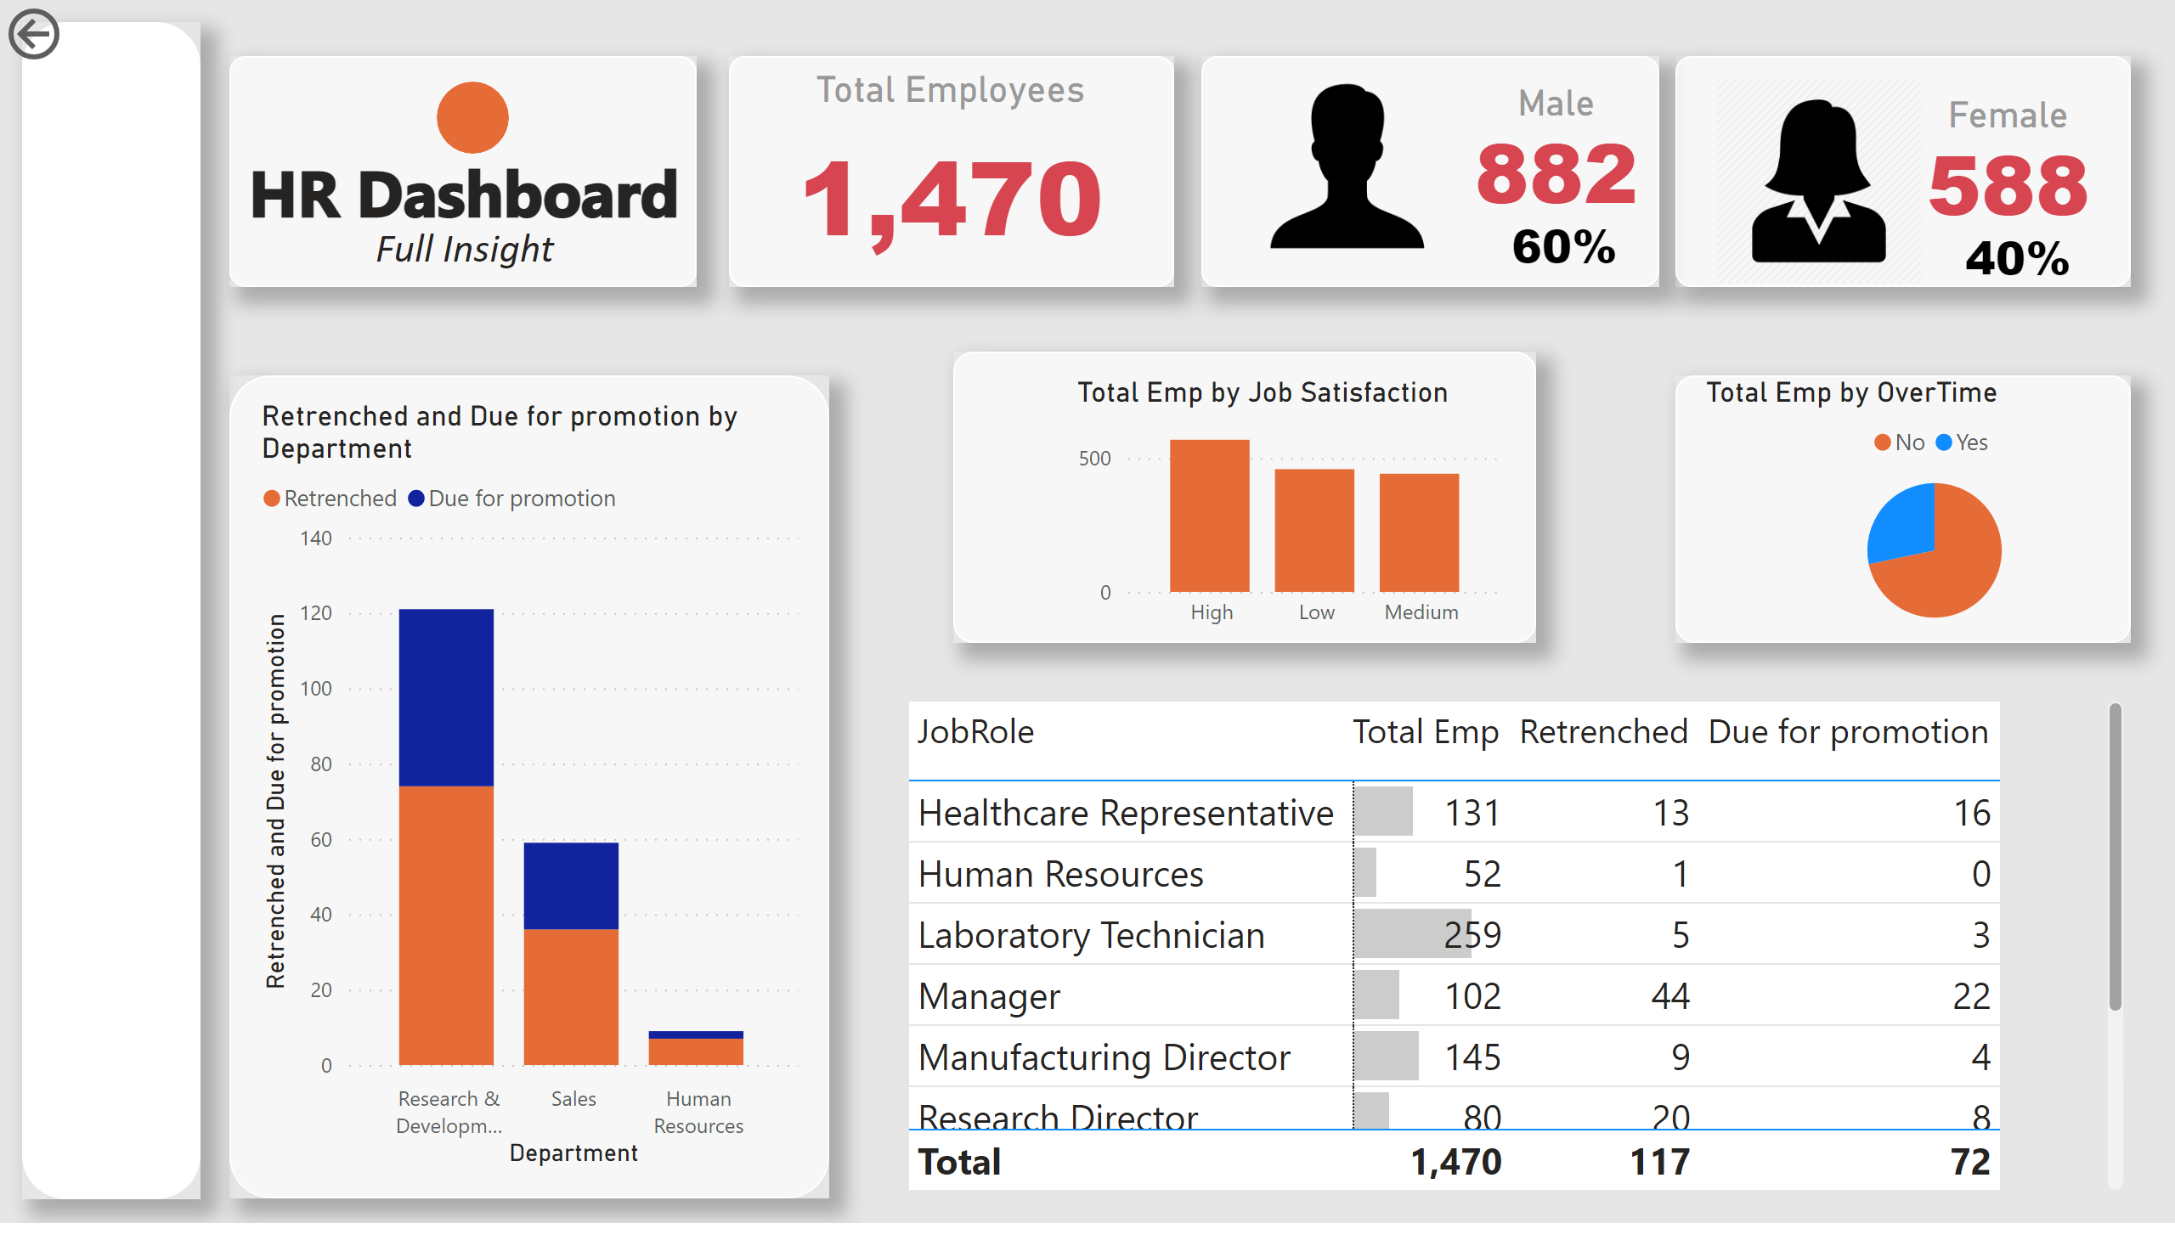
Detail
Notes:
shape
No alt text provided
shape
No alt text provided
shape
No alt text provided
shape
No alt text provided
shape
No alt text provided
textbox
No alt text provided
textbox
No alt text provided
shape
No alt text provided
Total Employees
No alt text provided
Male
No alt text provided
Male
No alt text provided
Male
No alt text provided
Female
No alt text provided
image
No alt text provided
image
No alt text provided
actionButton
No alt text provided
shape
No alt text provided
columnChart
No alt text provided
shape
No alt text provided
shape
No alt text provided
clusteredColumnChart
No alt text provided
pieChart
No alt text provided
tableEx
No alt text provided

